Slide 1
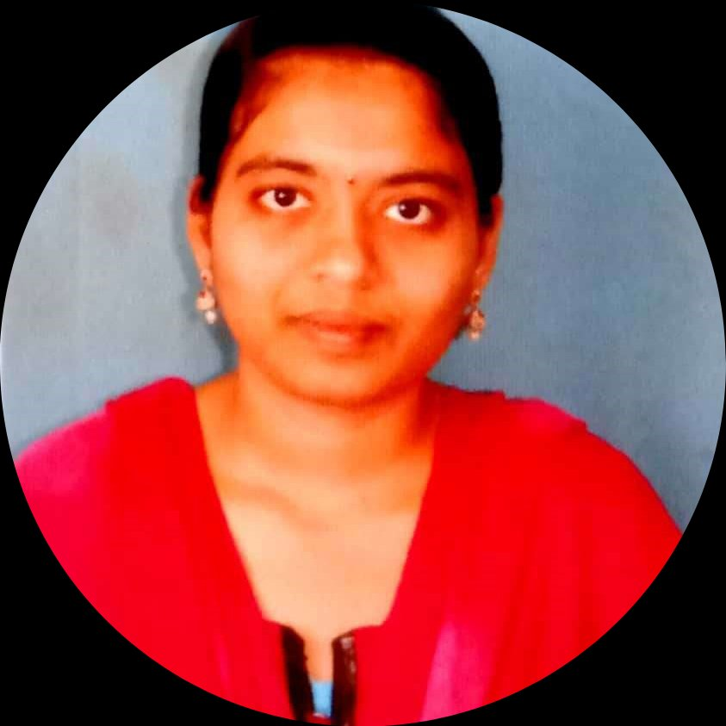
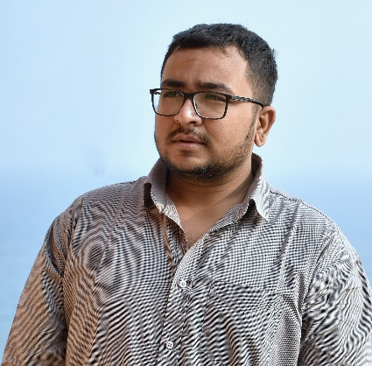


CHAVATA GEETHA VANI
Bachelor of Technlogy, Computer Science and Engineering:2015 -2019
Analyst/Software Engineer
Skills
Java | Java Basics, OOPS, Generics, Collections, Arrays, Loops
C# | C#Basics,OOPS,Generics,Collections, Array,Loops,LINQ
.NET | ADO.NET,ASP.NET with MVC5 and WEB API,Entity Framework
Database | MySQL
Tools | Git, Postman, Swagger, Visual Studio, Visual Studio Code
Add On skills | Peer learning
Bengaluru
chavata-geetha.vani@capgemini.com
+91 9948081518
A4
Full Stack Developer training on dotNet
. Git and GitHub
SQL and RDBMS
C# Intermediate
ADO.net, Entity framework, LINQ.
ASP dotNet Core Web App(MVC)
Asp dotNet Core Web API
HTML, CSS , JavaScript , Typescript
Angular
Ongoing training on Azure
Created a Online Shopping Cart Application With MySQL
Backend and WebAPI Core as middleware and Angular
as frontend Used HTML, CSS and TypeScript for the
deigning.
Project Video Link 🎥 : https://drive.google.com/file/d/1aIQWyJeU4jclgxfS4MdKmfaPDyzedgcL/view?usp=drivesdk
Check Out the full Project With Code On My GitHub.
Check out my work on GitHub

